Slide 1
Identification of ice particle types using radar and ceilometer depolarisation observations
Dmitri Moisseev¹, Maximilian Maahn², Nils Pfeifer², Annakaisa von Lerber³
¹ University of Helsinki, Finland
² University of Leipzig, Germany
³ Finnish Meteorological Institute, Finland

Slide 2
Why depolarization observations are interesting?
Lidar/ALC:
8 cloud profiling stations are currently reporting lidar volume depolarisation (Hyytiälä, Kenttärova, Leipzig, Limassol, Melpitz, Mindelo, Payerne, Warsaw)
Cloud radars:
12 stations report LDR observations (Bucharest, Campina, Hyytiälä, Julich, Kenttärova, Lampedusa, Limassol, Lindenberg, Mindelo, Munich, Norunda, Potenza)
What do these observations tell us about cloud microphysics?

Slide 3
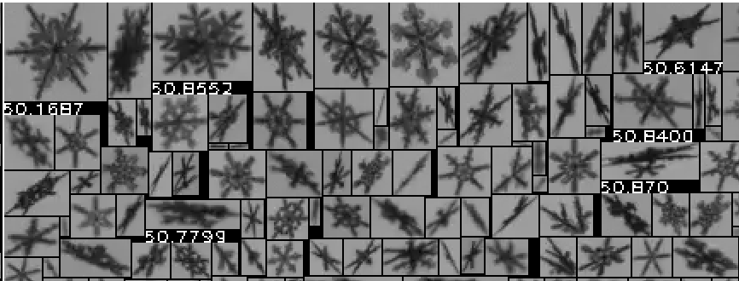
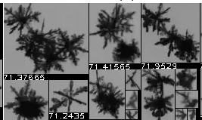
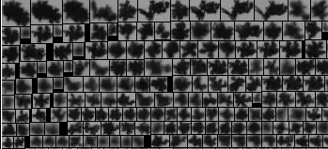
Can we identify the transition from one particle type to another
What are the LDR and δ (lidar volume depolarisaiton) values for crystals?
How LDR and δ changes during aggregation?
How riming affects LDR and δ values?

Slide 4
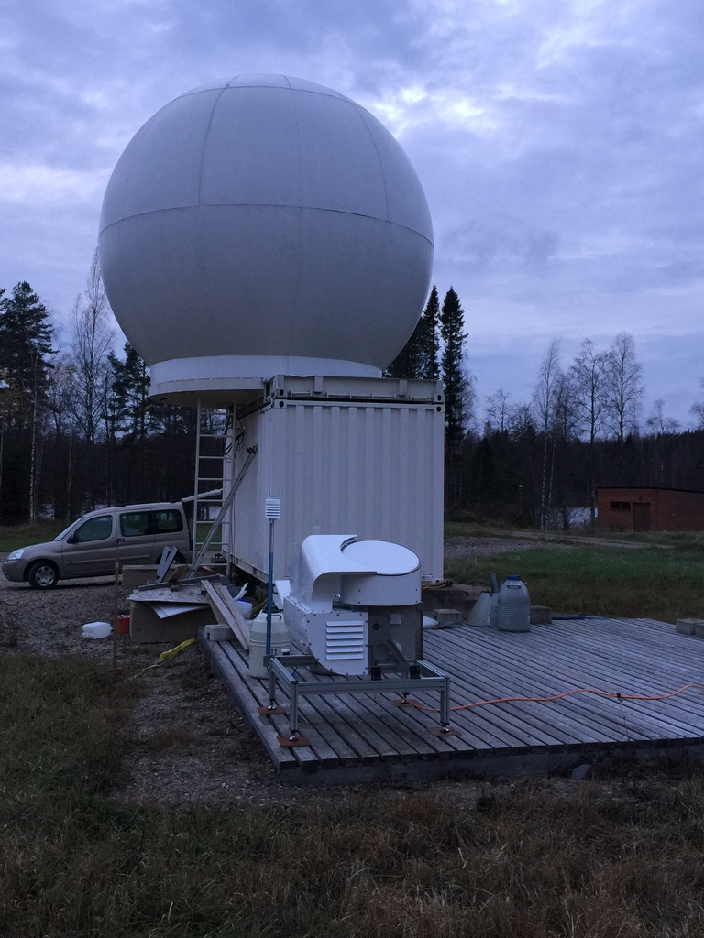
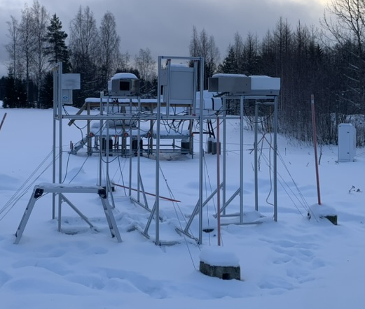
Hyytiälä measurements
Video In-Situ Snowfall Sensor (Univ. Leipzig)
High-resolution images (40-60 μm) from 2 angles, PSD, velocity, particle images
94 GHz cloud radar
EL = 90º λ = 3 mm, LDR
Vaisala CL61
EL = 87º λ = 910.5 nm, depolarization ratio
Collocated observations during winters: 2021/22, 2023/24, 2024/25, 2025/26
Maahn, M., Moisseev, D., Steinke, I., Maherndl, N., and Shupe, M. D., (2024): Introducing the Video In Situ Snowfall Sensor (VISSS), Atmos. Meas. Tech., 17, 899–919, https://doi.org/10.5194/amt-17-899-2024

Slide 5
VISSS Observations
Proxy for mass weighted mean diameter
Particle complexity, ratio of particle perimeter to perimeter of a disk with the same area (Garrett et al., 2012)

Slide 6
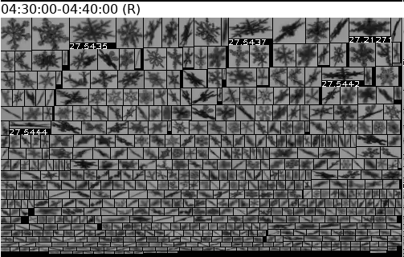
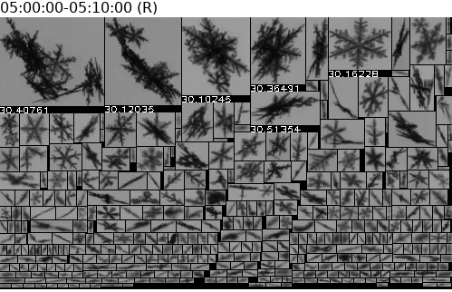
Low lidar depolarisation values (0.05) in pristine dendrites / aggregation rises them to 0.1
Dendrites
δ = 0.05 +/- 0.02
LDR = -26 dB
Max complexity 2.23
D₃₂ = 1.6 mm +/- 0.4
dendrites
Dendrites + early aggregates
δ = 0.1 +/- 0.015
LDR = -26 dB
Max complexity 2.5
D₃₂ = 2.9 mm +/- 0.7
Particle size and δ values are correlated
Similar LDR and δ values were observed in other cases

Slide 7
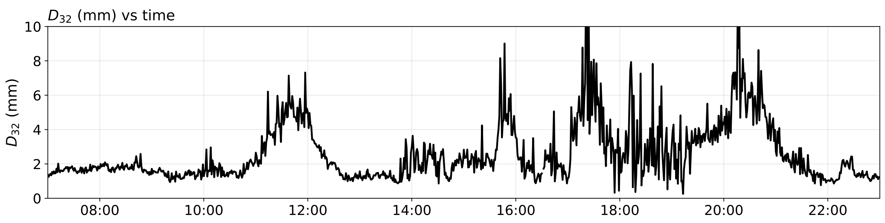
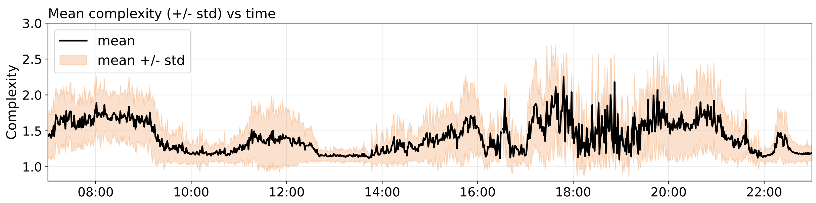
In this case D₃₂ and δ are not correlated

Slide 8
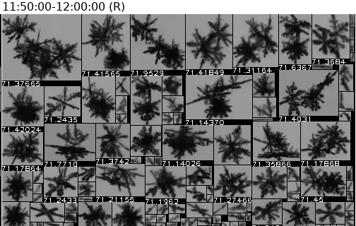
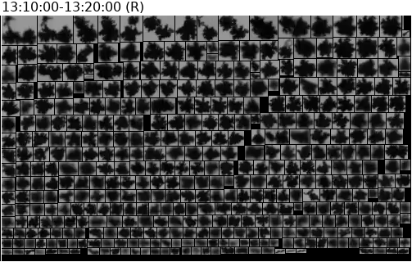
Aggregates and graupel like particles exhibit differences in LDR values
Both exhibit high δ values
Aggregates of dendrites
δ = 0.32 +/- 0.03
LDR = -21 dB
Max complexity 2.5
D₃₂ = 5 mm +/- 0.7
Graupel
δ = 0.32 +/- 0.06
LDR = -27 dB
Max complexity 1.74
D₃₂ = 1.2 mm +/- 0.7

Slide 9
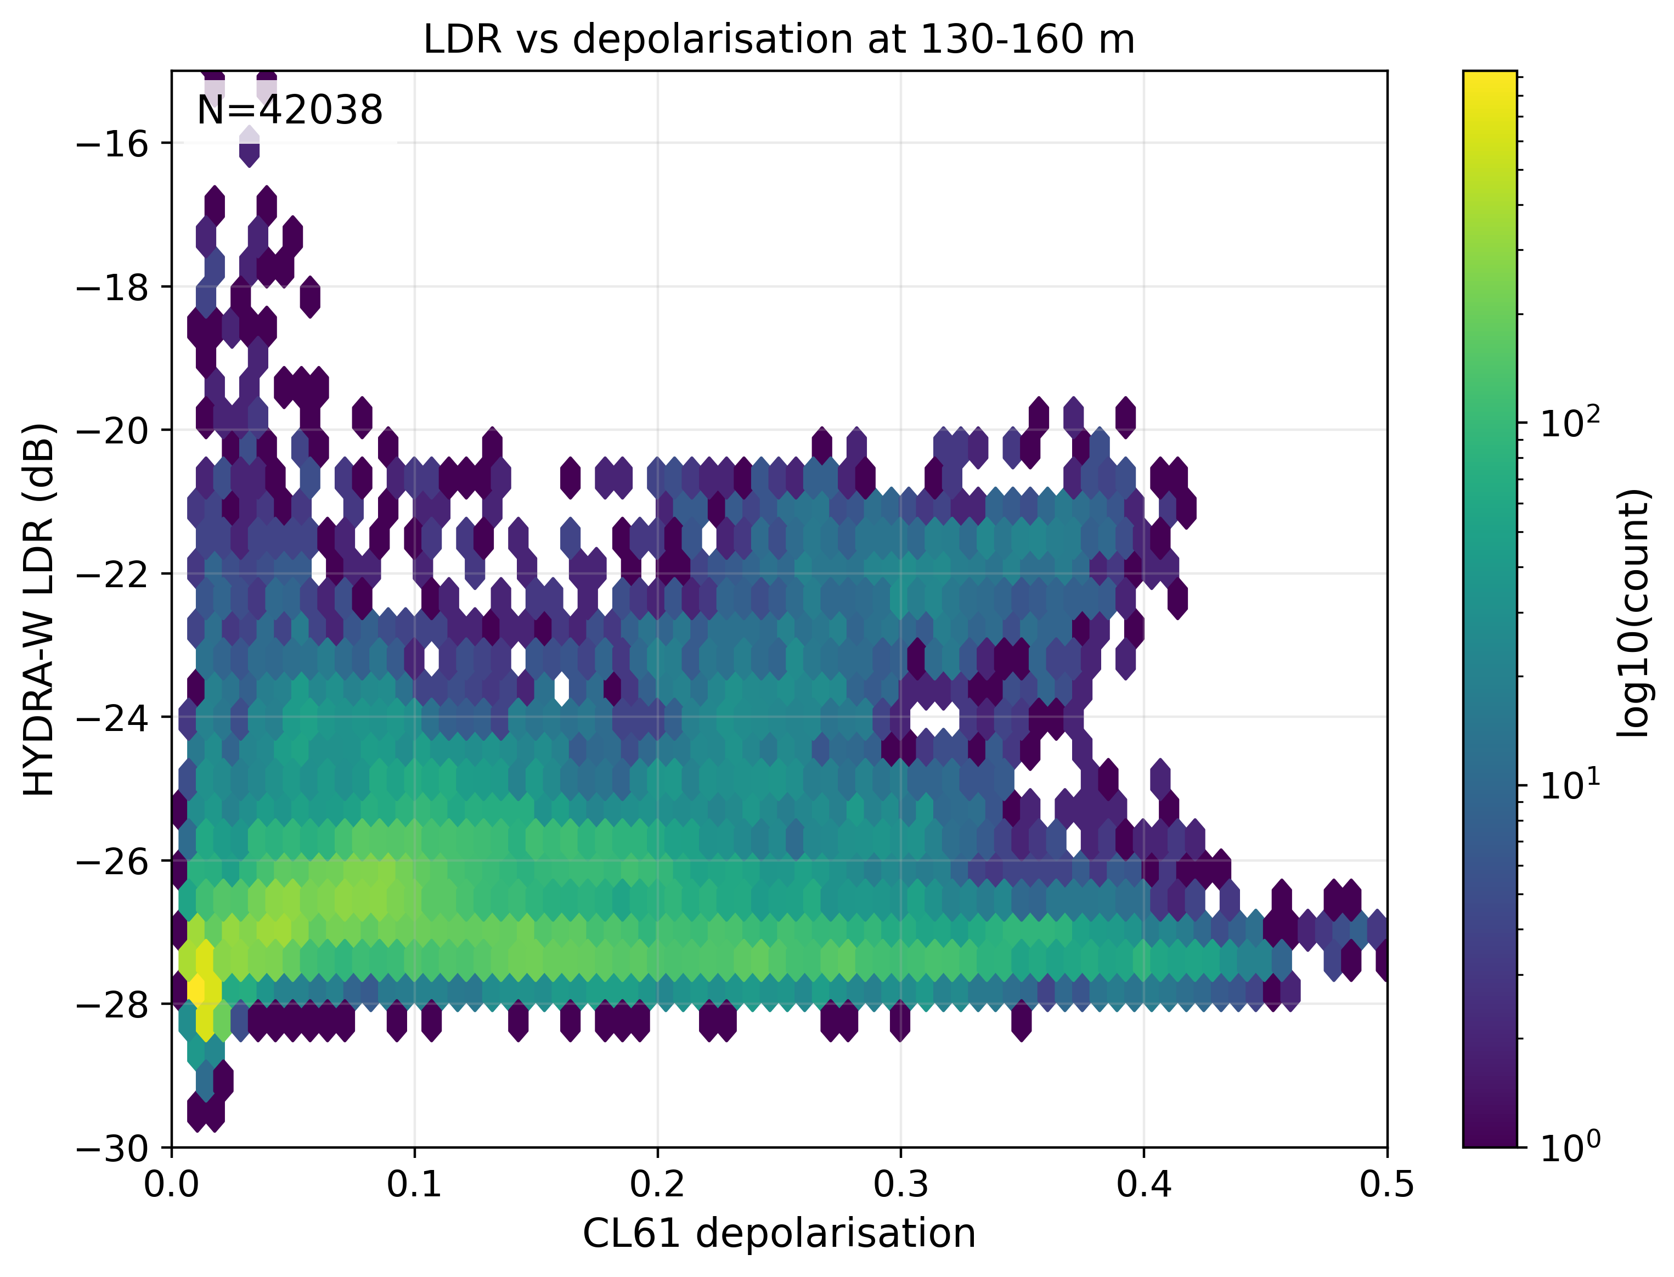
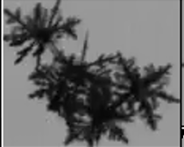
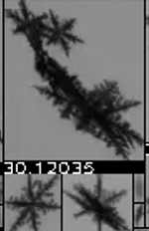
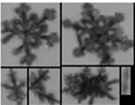
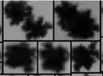
Conclusions
Lidar volume depolarisation and radar LDR can be used to identify particle growth processes
Dendrites – low LDR and depolarisation values
Aggregation – increases both LDR and lidar depolarisation
Riming – increases lidar depolarisation and (slightly decreases) LDR
Mixed-phase
Aggregation
Dendrites
Riming

